Slide 1
Application Of Optical Flow

Slide 2
What Is Optical Flow for? -from ECCV 2018 workshop paper
Who benefit from it? (results from the survey)
Next-frame prediction, action recognition or localization, object tracking, video semantic segmentation, video object detection.
From speakers:
The persistency of the three-dimensional world
Action understanding
Visualization

Slide 3
We will focus on:
Video inpainting
Crowd analysis
Tracking
Segmentation

Slide 4
About video inpainting
Task
Previous work
Paper 1 Deep Flow-Guided Video Inpainting
Paper 2 Frame-Recurrent Video Inpainting by Robust Optical Flow Inference
Paper 3 VORNet: Spatio-temporally Consistent Video Inpainting for Object Removal
Paper 4 Video-Rate Video Inpainting

Slide 5
Task
There are two highly related or similar tasks:
To fill in missing regions of a given video sequence with contents that are both spatially and temporally coherent.
Given the mask of the foreground object in each frame, to generate a video without the target object.

Slide 6
Previous work
Non-learning-based Inpainting:
Diffusion-based method, patch-based method
Learning-based Inpainting:
CNN (GAN,2D&3D)
LSTM
Notes:
A diffusion-based method propagates appearance information around the target hole for image completion. This approach is incapable of handling the appearance variations and filling large holes.
A patch-based method completes missing regions by sampling and pasting patches from known regions or other source images. This kind of approach has been extended to the temporal domain for video inpainting.
By using GAN, Pathak et al. [23] train an inpainting network that can handle large-sized holes. Iizuka et al. [15] improved [23] by introducing both global and local discriminators for deriving the adversarial losses. More recently, Yu et al. [35] presented a contextual attention mechanism in a generative inpainting framework, which further improves the inpainting quality. These methods achieve excellent results in image inpainting.
Wang et al. extended the CNN solution from image to video, proposing a hybrid network combining 2DCNN and 3DCNN. They used 3DCNN to recover the temporal coherence and 2DCNN to reconstruct the spatial details.
…ConvLSTM are powerful tools to model long-term temporal consistency for video related tasks

Slide 7
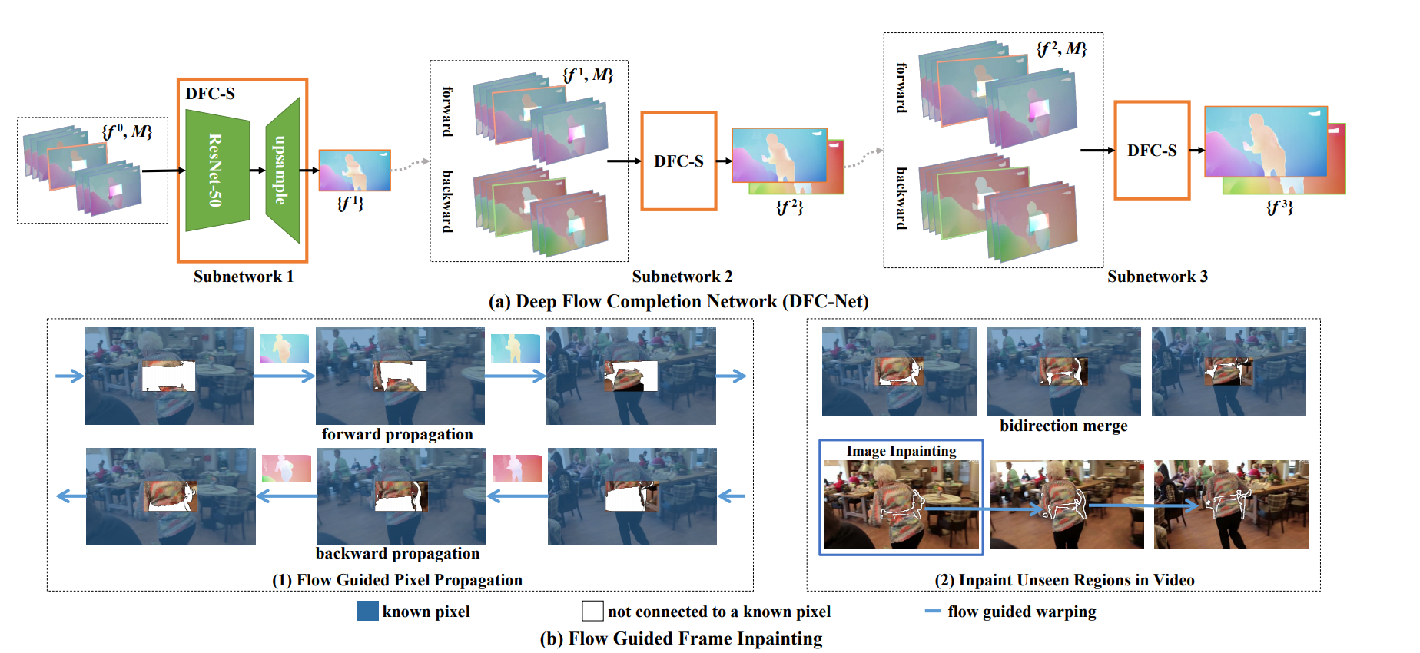
Paper 1 Deep Flow-Guided Video Inpainting
Consider video inpainting as a pixel propagation problem.
coarse-to-fine flow completion, maintaining temporal coherence, hard flow example mining, flow Guided Pixel Propagation
Notes:
三个DFC-S图像的大小：1/2，2/3，1,,,因为图像越小，缺失越小，越好填充
第一个DFC-S：先通过FlowNet2得到一系列的flow map,对缺失区域平滑插值，综合考虑，对DFC-S传入11个flow map和对应的mask, 输出的是中间帧的flow map.具体上：由ResNet50+upsample
第2个DFC-S：输入：1得到的双向flow,双流分别对应的mask, 输出双流中间帧的flow map
第三个与第二个类似

Slide 8
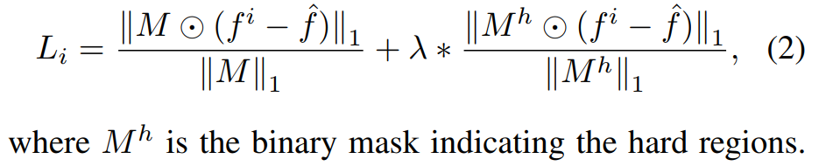
Hard flow example mining
Leverage the hard flow example mining mechanism to automatically focus more on the difficult areas thus to encourage the model to produce sharp boundaries.
Notes:
由于大多数区域都是光流区域都是smooth，因此在smooth和boundary的训练样本数量上存在倾斜

Slide 9
Flow Guided Pixel Propagation
Check the validity of the flow:
How to propagate:
After checking, if an unknown pixel is connected with both forward and backward known pixels, it will be filled by a linear combination of their pixel values whose weights are inversely proportional to the distance between the unknown pixel and known pixels.
But what if there’s unfilled area?
Apply the method by Yu et al. to one frame, and propagate the inpainting result to the entire video sequence based on the estimated optical flow.
Notes:
This condition means that after the forward and backward propagation, the pixel should go back to the original location.

Slide 10
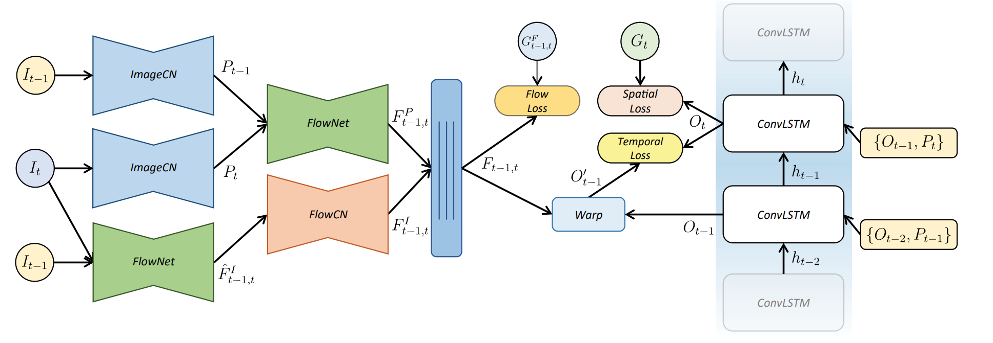
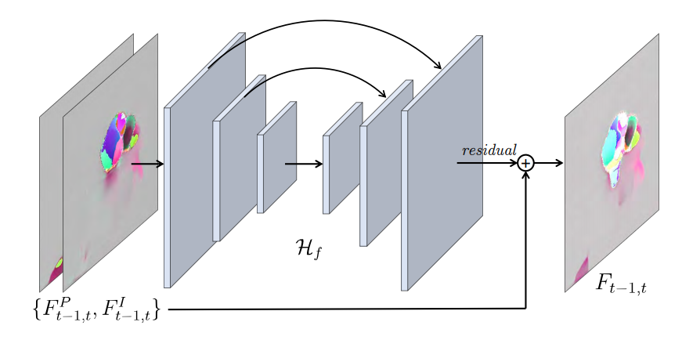
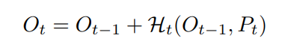
Paper 2 Frame-Recurrent Video Inpainting by Robust Optical Flow Inference
Able to handle videos of arbitrary length and frame size.
A ConvLSTM based network combines the temporal and spatial constraints.
A robust motion estimation network via trainable optical flow fusion module enables the prediction of large motions.
Notes:
two sources of the optical flow
Pt: separately inpainted frames
FlowCN : an optical flow completion network
中间的蓝条Hf：Flow blending network：：：U-Net+residual

Slide 11
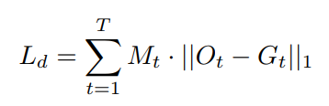
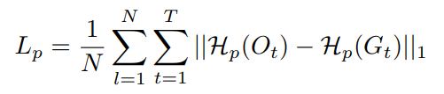
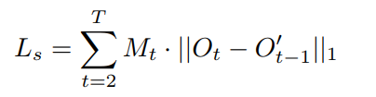
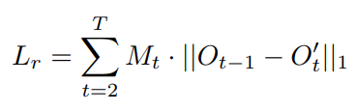
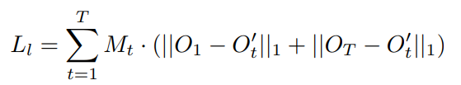
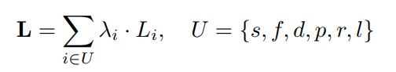
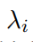
Training Losses
Spatial losses: per-pixel loss --
perceptual losses--
Short-term temporal losses:
Long-term temporal losses:
The overall loss: is manually pre-defined
Notes:
Hp is a pre-trained feature extractor such as ResNet or VGG-16 as used in this paper, and N is the number of feature maps of Hp
???loss里最后的Lf???

Slide 12
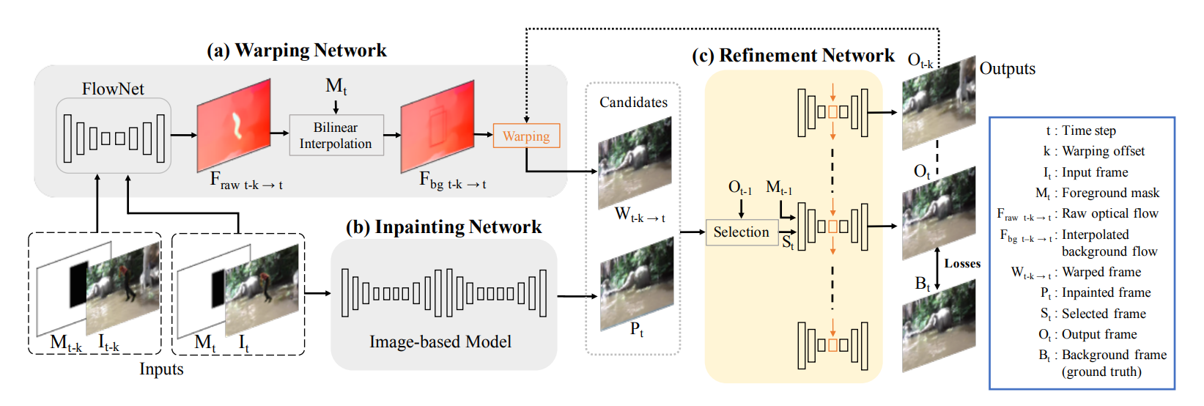
Paper 3 VORNet: Spatio-temporally Consistent Video Inpainting for Object Removal
the first learning based model for video object removal
spatial content losses and temporal coherent loss based on GAN
the first large-scale Synthesized Video Object Removal (SVOR) dataset
Notes:
1．Warping Network：用FlowNet2得到t-k和t帧的光流，但是去除前景区域的光流，用双线性插值补，最后，wrap Ot-k 的前景区域和对应的光流，得到一个备选，输入refinementNet
2.Inpainting Network：adopt the generative inpainting network from Yu et al. a coarse network+ a refinement network
3.Refinement Network：
(1)从warped frames and the inpainted frame中，在the feature level (LPIPS distance)上，选择和前一个结果最接近的St。
(2)三个卷积层encode St 和Mt, 通过一个convLSTM保持时间上的特征，再反卷积得到结果。

Slide 13
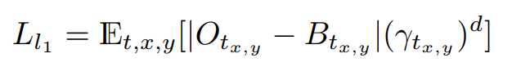
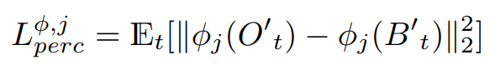
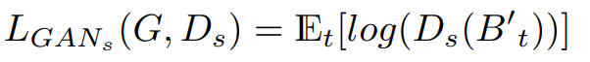
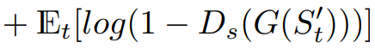
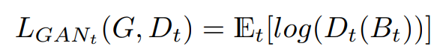
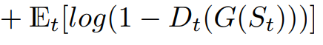
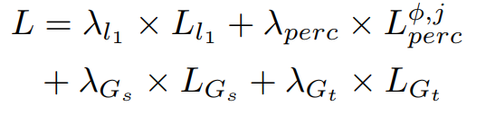
Training Losses
Spatially discounted reconstruction loss:
VGG perceptual loss:
PatchGAN loss:
Temporal GAN loss:
The overall loss:
Notes:
loss in each pixel is weighted by γ d according its distance d to the nearest boundary. Reason::since pixels closer to the boundary should match the background, while the middle part could have more diversity.
The perceptual loss emphasizes on the higher level of difference like style or textures instead of pixels.
To motivate our model to generate realistic images, we use the PatchGAN discriminator as our spatial discriminator Ds
we need a temporal constraint to generate content coherent videos

Slide 14
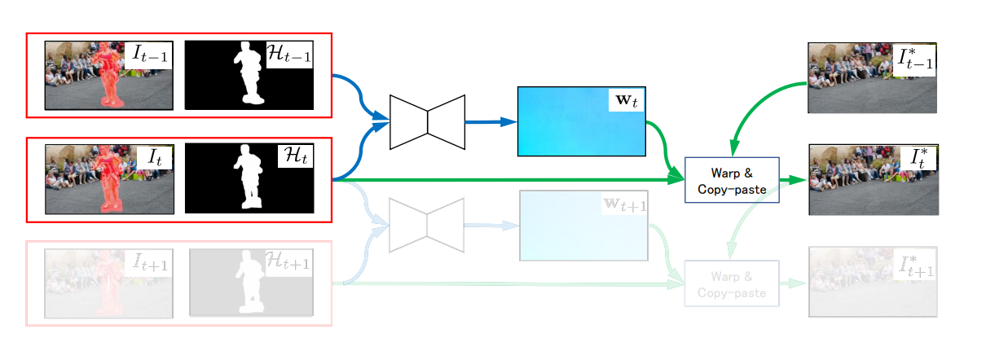
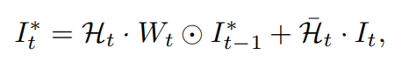
Paper 4 Video-Rate Video Inpainting
use CNNs for the estimation of flow of occluded regions
use synthetic data
Achieve video-Rate ( 32 fps for 832 × 448 pixel videos )
Notes:
Estimate the flow w(x) using (It−1, It) and (Ht−1, Ht) mask
2) Fill in the pixels of It beloging to the mask provided by Ht , where image interpolation (eg., bilinear) is employed.
数据集：flying chairs上加上遮挡物（先用5条线），但不改变GT光流，让CNN去学习如何在遮挡处插值
线的宽度的影响：用粗线条去训练，用细线去检测，效果可以；相反就不可。
将线换成其他形状遮挡物训练，效果差异不大。

Slide 15
About crowd analysis
Task
Previous work
Paper 1 Optical Flow Dataset and Benchmark for Visual Crowd Analysis
Paper 2 Plug-and-Play CNN for Crowd Motion Analysis: An Application in
Abnormal Event Detection
Paper 3 Abnormal Behavior Detection in Crowded Scenes Using Density
Heatmaps and Optical Flow

Slide 16
Task
There are many tasks in crowd analysis.
Here, we mainly discuss:
1. frame level for anomaly detection
2. pixel level for anomaly localization

Slide 17
Previous work
Classic:
to first learn the normal patterns, and then detect anomalies as events deviating from the normal patterns.
relies on the extraction of local features: histogram of oriented gradients, the histogram of oriented flows, optical flow, spatiotemporal video volumes
Deep learning methods:
CNN ( 3D ConvNet, autoencoder )
LSTM
Notes:
learning models on motion and/or appearance features, employing standard hand-crafted features.
capturing the local irregularity of the low-level motion features or high-level detectors.
Ravanbakhsh et al. proposed a complex feature structure on top of CNN features which can capture the temporal variation in a video for the task of activity recognition.

Slide 18
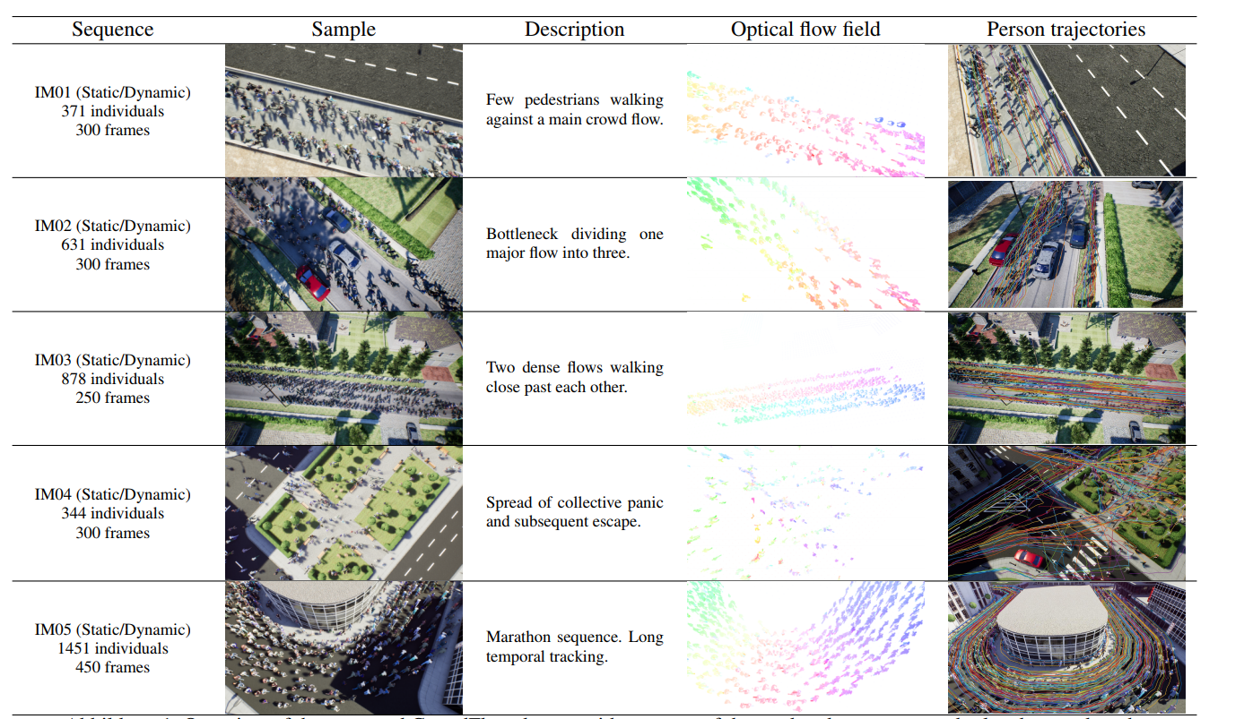
Paper 1 Optical Flow Dataset and Benchmark for Visual Crowd Analysis
New challenge: precise motion estimation of numerous small, partly independent, self-occluding, non rigidly moving individuals; consistency over a long temporal range.
Notes:
新的挑战：大量小的、部分独立的、自遮挡的、非刚性移动的物体在长时间范围内的准确估计

Slide 19
design criteria
Platform: static and dynamic
Crowd Density: 371~1451 independently moving individuals
Crowd Movements: diversity
Temporal Consistency
Portability: from synthetic to real-world
Evaluation Metrics
Optical Flow Metrics: EPE and R2 values
Long-term Motion Metrics: tracking accuracy
Run time
Notes:
实验说明：现有方法在动态上表现差，人群分析时，指标2比光流指标更有鉴别力，现有的基准测试集在人群分析上不可靠，与UCF对比确认本数据集的可靠性。

Slide 20
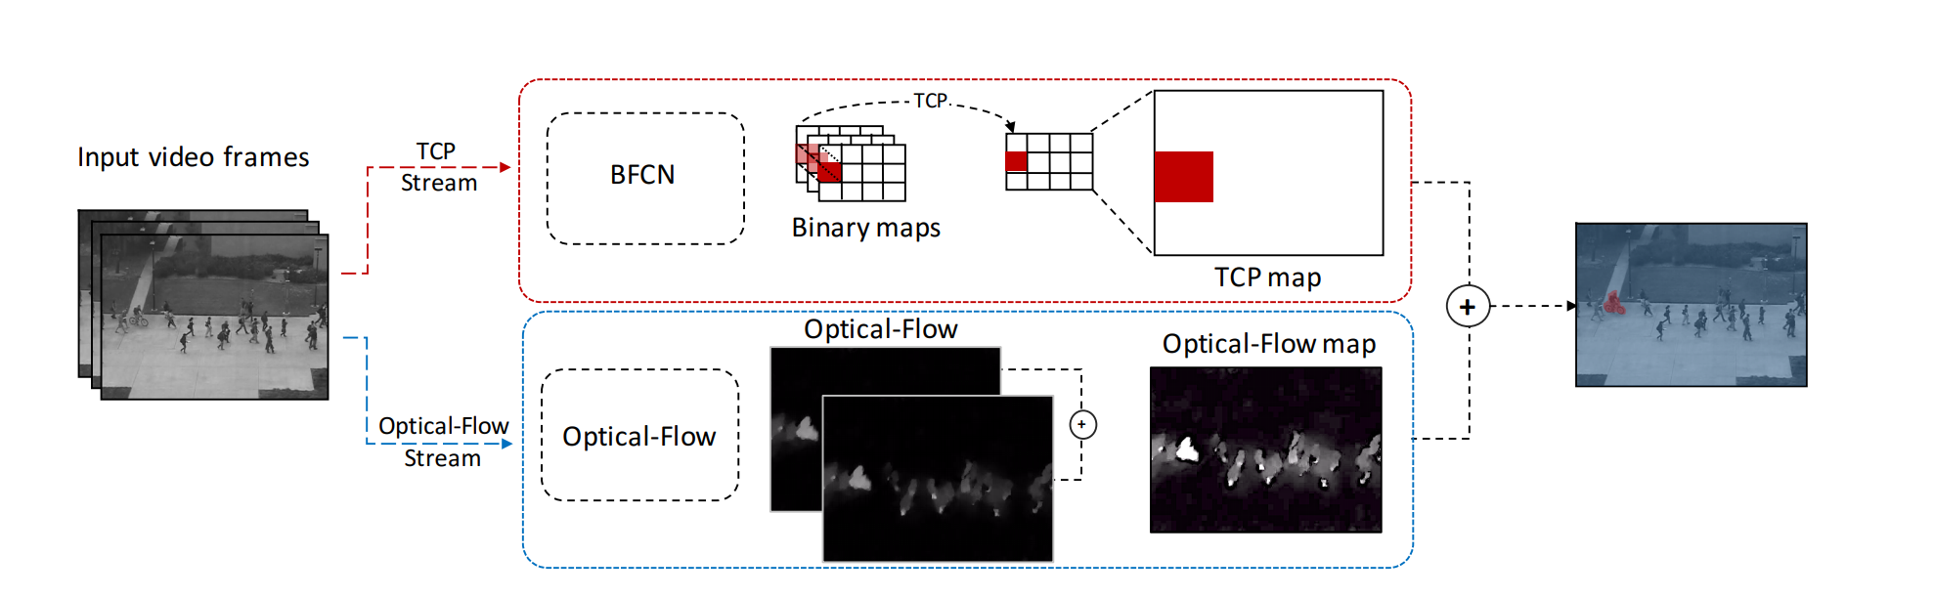
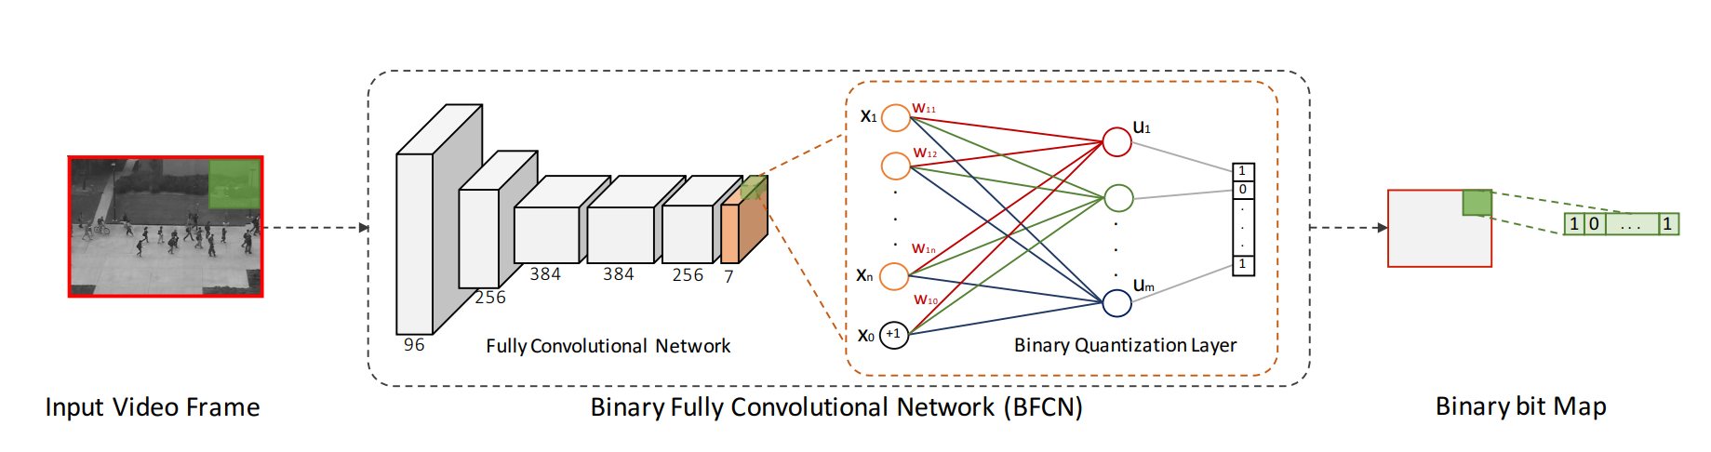
Paper 2 Plug-and-Play CNN for Crowd Motion Analysis: An Application in Abnormal Event Detection
Binary Quantization Layer
Temporal CNN Pattern(TCP)measure to represent motion in crowd
Notes:
BFCN: AlexNet + Binary Quantization Layer,得到Binary bit Map
TCP（temporal CNN patterns）：计算TCP measure,通过上采样得到原图像大小的TCP map.
通过计算二进制代码直方图上的不规则性来捕获这种随时间的变化。将异常度量为二进制码直方图的均匀性。因此，平的二进制模式的直方图意味着视觉模式的不一致性，因此增加了异常的几率。
Fusion: 由于光流只是对于两张图片，而TCP map是对一个序列，因此要得到一个光流序列dt,对dt采用之前对patch pt相似的操作得到optical-flow Maps，最后，对两个map加权（0.5，0.5）

Slide 21
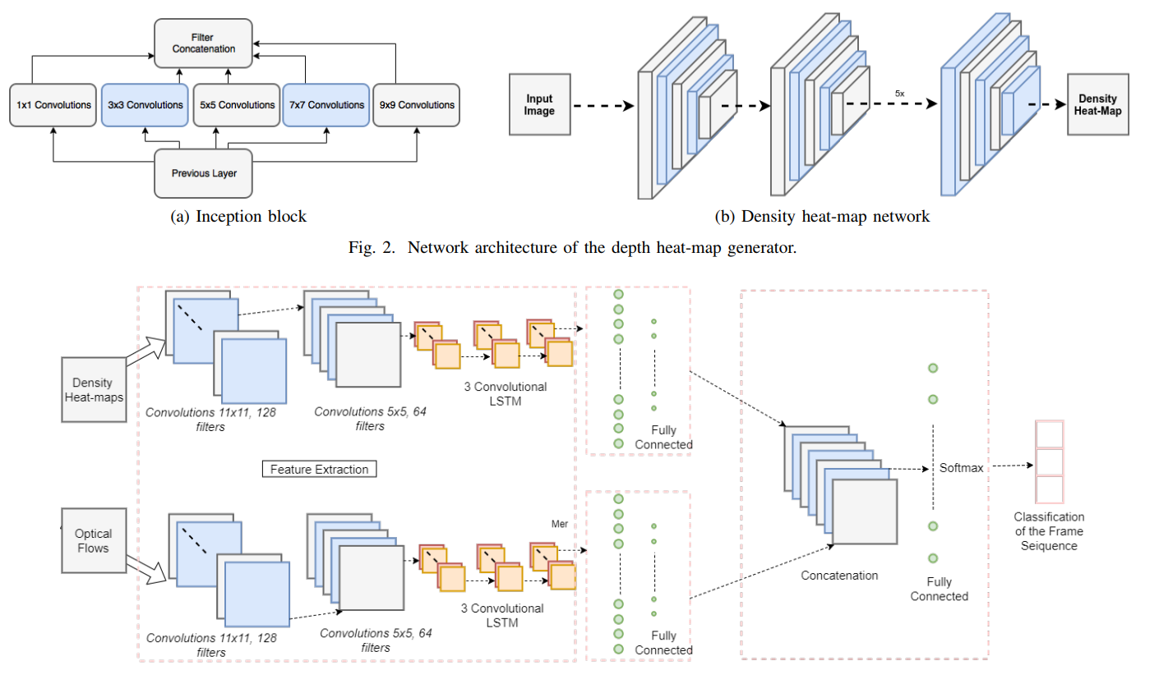
Paper 3 Abnormal Behavior Detection in Crowded Scenes Using Density Heatmaps and Optical Flow
using crowd density heat-maps as an attention mechanism
a new dataset
Notes:
热力图：create an inception-like network, equipped with filters of different sizes in order to produce density heatmaps.
光流图：FlowNet2
Two stream Feature extraction : a convolutional spatiotemporal network +LSTM ------to learn the regular patterns in the training videos, in time and space
The outputs of each model ended up in two fully connected layers and then merged.

Slide 22
About tracking
Task
Previous work
Paper 1 Object Tracking in Satellite Videos Based on a Multi-Frame Optical Flow Tracker
Paper 2 End-to-end Flow Correlation Tracking with Spatial-temporal Attention
Paper 3 Improving Multiple Object Tracking with Optical Flow and Edge Preprocessin

Slide 23
Task
Given: the initial position and extent of a target object in the initial image
The goal: to estimate the position and extent of the target in subsequent frames.
Notes:
Given the initial position and extent of a target object in the initial image, the goal of object tracking is to estimate the position and extent of the target in subsequent frames.
estimate the pose of all persons appearing in the video and assign a unique identity to each person over time

Slide 24
Previous work
DCF trackers:
use handcrafted features, which hinder their accuracy and robustness
combination of DCF framework and CNN features
CNN-based trackers
to learn the target-specific features
Optical flow for visual recognition
Notes:
discriminative methods, correlative filter methods, deep learning methods
DCF trackers:
discriminative correlation filters (DCF): use handcrafted features, which hinder their accuracy and robustness
combination of DCF framework and CNN features
CNN-based trackers
design the tracking networks and pre-train them in order to learn the target-specific features
Shortcoming: only consider appearance features in current frame and can hardly benefit from motion and inter-frame information.
Optical flow for visual recognition

Slide 25
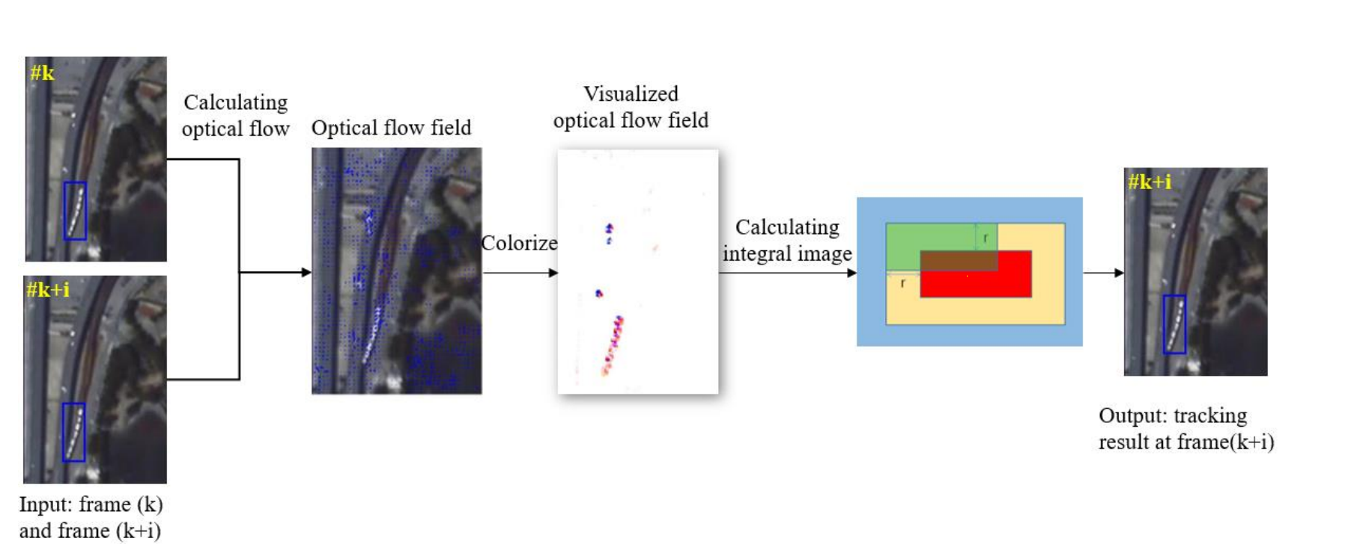
Paper 1 Object Tracking in Satellite Videos Based on a Multi-Frame Optical Flow Tracker
Challenge : large scene size, small target size, less features and more similar background, bigger illumination variation influence.
Solution : optical flow, HSV Color system, integral image, multi-frame difference
Notes:
Procedure:
1.The satellite video frames are firstly disposed by Lucas-Kanade optical flow method to get an optical flow field.
2.The HSV Color system is used for converting two-dimensional optical flow field into a three-channel color image.
3.The integral image is employed to obtain the most probable position of target.
4.In addition, since most interested targets move slightly in satellite videos, multi-frame difference method is applied to locate a more accurate position of the moving target.
In 4, need to find the best interval i (frame k, frame k+i )

Slide 26
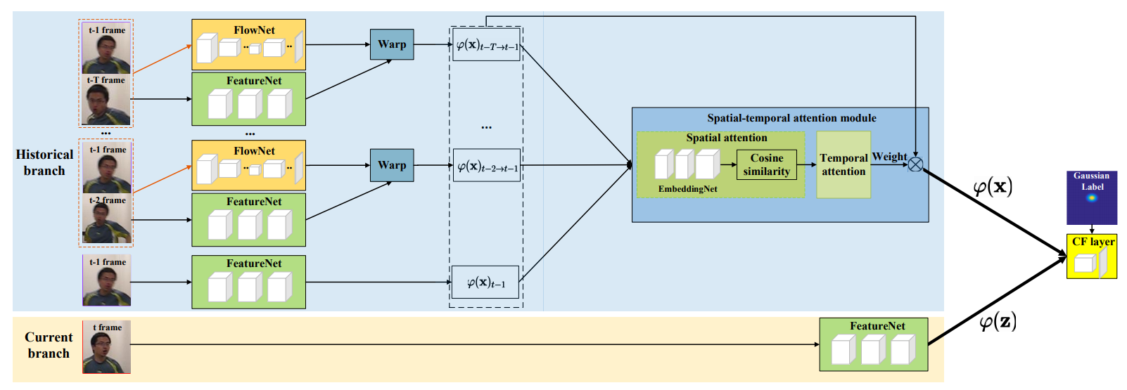
Paper 2 End-to-end Flow Correlation Tracking with Spatial-temporal Attention
End-to-end flow correlation tracking framework
A novel spatial-temporal attention mechanism
Notes:
procedure:
1.In historical branch, appearance features and flow information are extracted by the FeatureNet and FlowNet.
2. previous frames at predefined intervals (5 frames in experiments, T = 6) is warped to t−1 frame guided by flow information.
3. a spatial-temporal attention module is designed to weight the warped feature maps.
4. In another branch, the feature maps of current frame is extracted by FeatureNet.
5. both two branches are fed into subsequent correlation filters layer for training

Slide 27
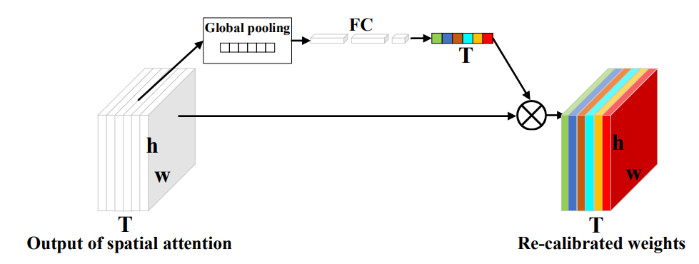
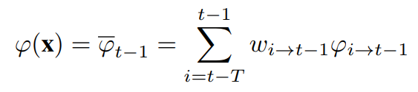
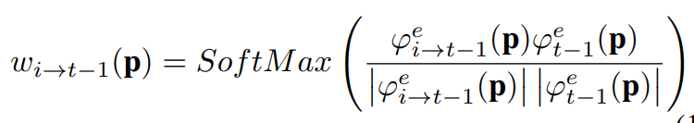
Spatial-temporal attention
The aggregation results:
Spatial attention:
Temporal attention: re-weighting by the temporal attention sub-network architecture
Notes:
图片：The temporal attention sub-network architecture
1.the output of spatial attention module is first passed through a global pooling layer to produce a channel-wise descriptor.
2. three fully connected (FC) layers are added, in which learned for each channel by a self-gating mechanism based on channel dependence.
3. re-weight the original feature maps to generate the output of temporal attention module

Slide 28
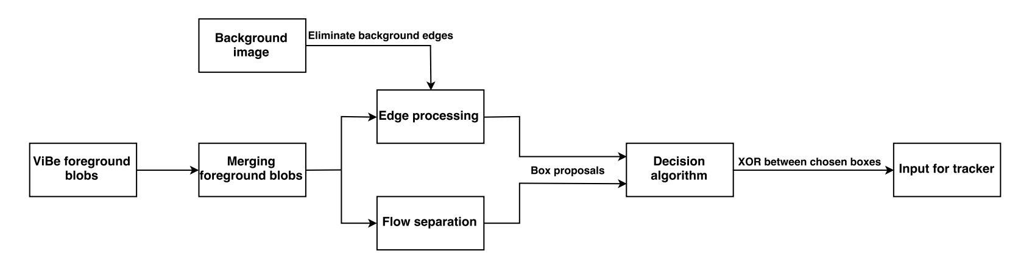
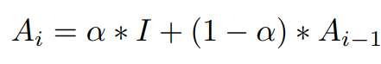
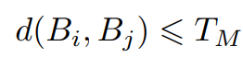
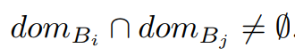
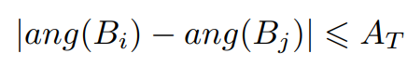
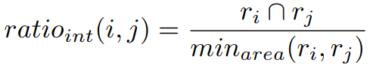
Paper 3 Improving Multiple Object Tracking with Optical Flow and Edge Preprocessing
Main purpose: creating better foreground images
Background image:
Merging foreground blobs if:
Flow separation：
Edge processing：XOR, group to separate
Decision algorithm: 4 checks
Notes:
where α is an accumulation rate and I is an input image. In the experiments, α = 0.01, which means that each new frame has a weight of 0.01 in the running average and the mean image has a weight of 0.99.
Merge:最小像素距离，区域交集，光流夹角
Flow Separate：使用kmeans聚3类，共得到3个ratio, 分别与阈值0.4比较，若小，在比较光流夹角，若相反，则保留这两类的框，即分成了两个。
Edge::
从Background image 和 current image 分别通过the Canny edge detector 得到 EA and EI，对其中对应像素XOR后得到EF：：eliminate the background edges from the foreground blob edges，eliminate foreground blobs that were in fact background objects
对EF，先随机取边缘上一点，并取与之曼哈顿距离小于3的边缘点，形成一个group,Gi, 重复直到所有点都有分组；然后，为每个Gi, 找最大的bounding box ri；ri的数量对应于前景blob中不同物体的数量。
Decision algorithm:
if an RoI has been modified by the flow separation ,keep the two boxes returned by the optical flow
if an RoI has been modified both by the flow merging and the edge precessing, we keep the boxes from the edges processing
If the number of boxes that the edge processing step returned is greater or equal than four, we ignore them and simply keep the one box proposed by the optical flow.
when the edges proposed two boxes, ei and ek, and the optical flow only one, fk, compute the area ratio=eiUek/ef, if the ratio is smaller or equal to 0.65, keep the the single box fk from the optical flow processing
In other case, we simply favor the edge boxes

Slide 29
About segmentation
Task
Previous work
Paper 1 Optical Flow augmented Semantic Segmentation networks for Automated Driving
Paper 2 On guiding video object segmentation
Paper 3 Semantic Video Segmentation by Gated Recurrent Flow Propagation

Slide 30
Task
Semantic Video Segmentation:
For every frame of the given video, to assign each pixel in the frame a object class.
Video Object Segmentation:
pixel-wise labelling of each video frame as either foreground or background
Notes:
VOS can be formulated as a pixel-wise labelling of each video frame I as either foreground (1) or background (0), thus generating a foreground segmentation mask S.

Slide 31
Previous work
Semantic Video Segmentation:
patch-wise training
end-to-end learning of pixel-wise classification(FCN, SegNet)
geometry based approaches, CNN based optical flow
combine appearance and motion cues
Video Object Segmentation:
supervised, semi-supervised, unsupervised
new architecture, loss function variations, transfer learning, data augmentation, applying spatial attention
Notes:
patch-wise training
end-to-end learning of pixel-wise classification(FCN, SegNet)
motion detection : geometry based approaches, CNN based optical flow
combine appearance and motion cues
VOS : supervised, semi-supervised and unsupervised
new architecture, loss function variations , transfer learning , data augmentation, applying spatial attention

Slide 32
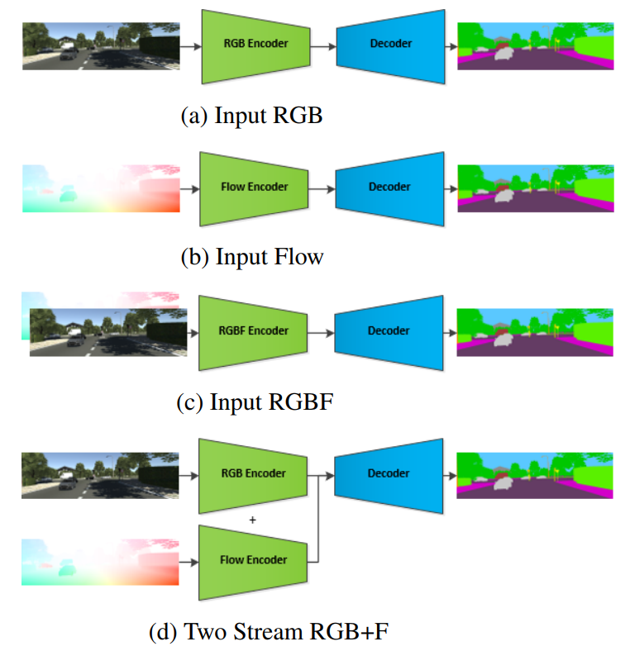
Paper 1 Optical Flow augmented Semantic Segmentation networks for Automated Driving
One-stream network: based on FCN8s
RGBF network:
Input RGB + flow map (4 channels)
Two stream (RGB+F) network：
two parallel VGG16 encoders
The goal of this work is to construct simple architectures to demonstrate the benefit of flow augmentation to standard CNN based semantic segmentation networks.
Notes:
Input RGB + flow map (4 channels) flow map: 向量的模并在（0，255）
two parallel VGG16 encoders，加和连接

Slide 33
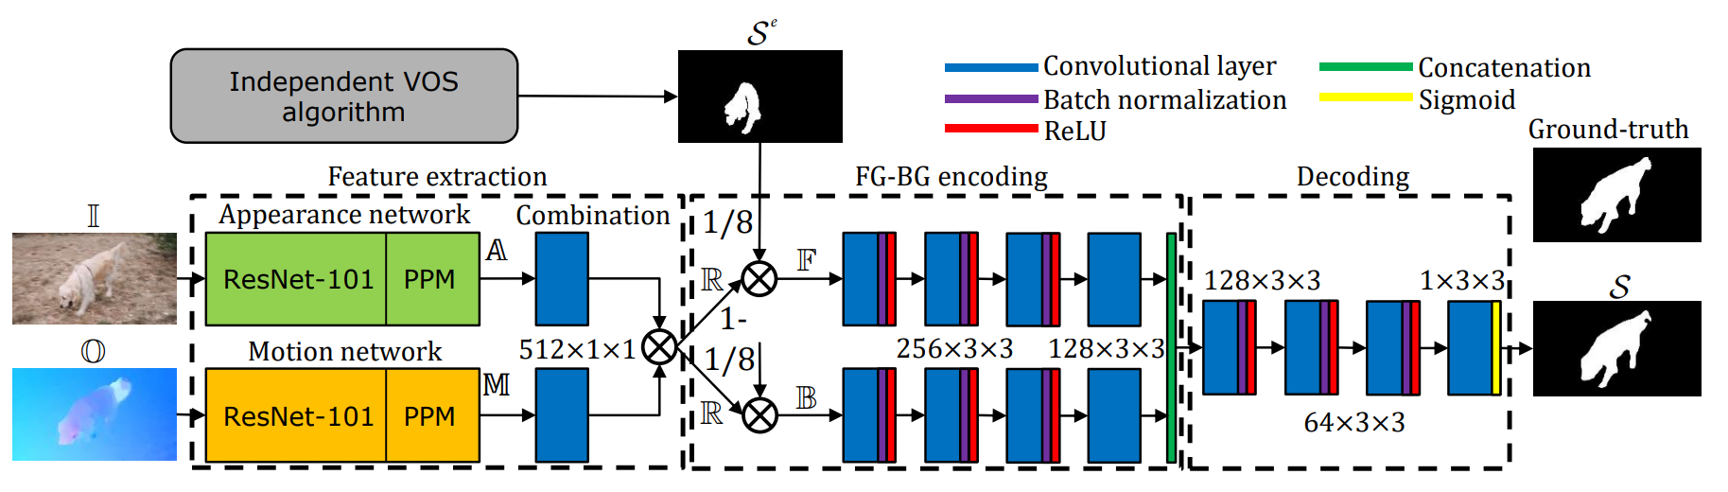
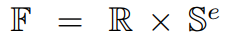
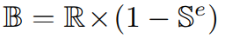
Paper 2 On guiding video object segmentation
Appearance network: PSPNet
Motion network: PSPNet, optical flow vectors -> 3-channel color-coded
Unified representation: 1 × 1 convolution + element-wise multiplication
Foreground and background encoding:
Notes:
Procedure:
given a video frame and its associated optical flow, two networks compute appearance A and motion feature maps M((both have 1/8 the original image resolution)
Two maps are combined by element-wise multiplication to obtain a unique representation R
Se is used to weight R and separately encode foreground F and background B information
The output of the two sub-networks is concatenated and decoded with a convolutional network to produce the foreground mask S.

Slide 34
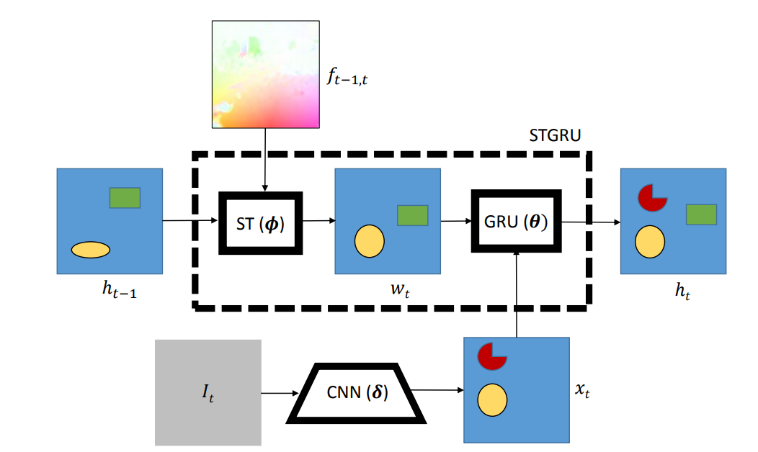
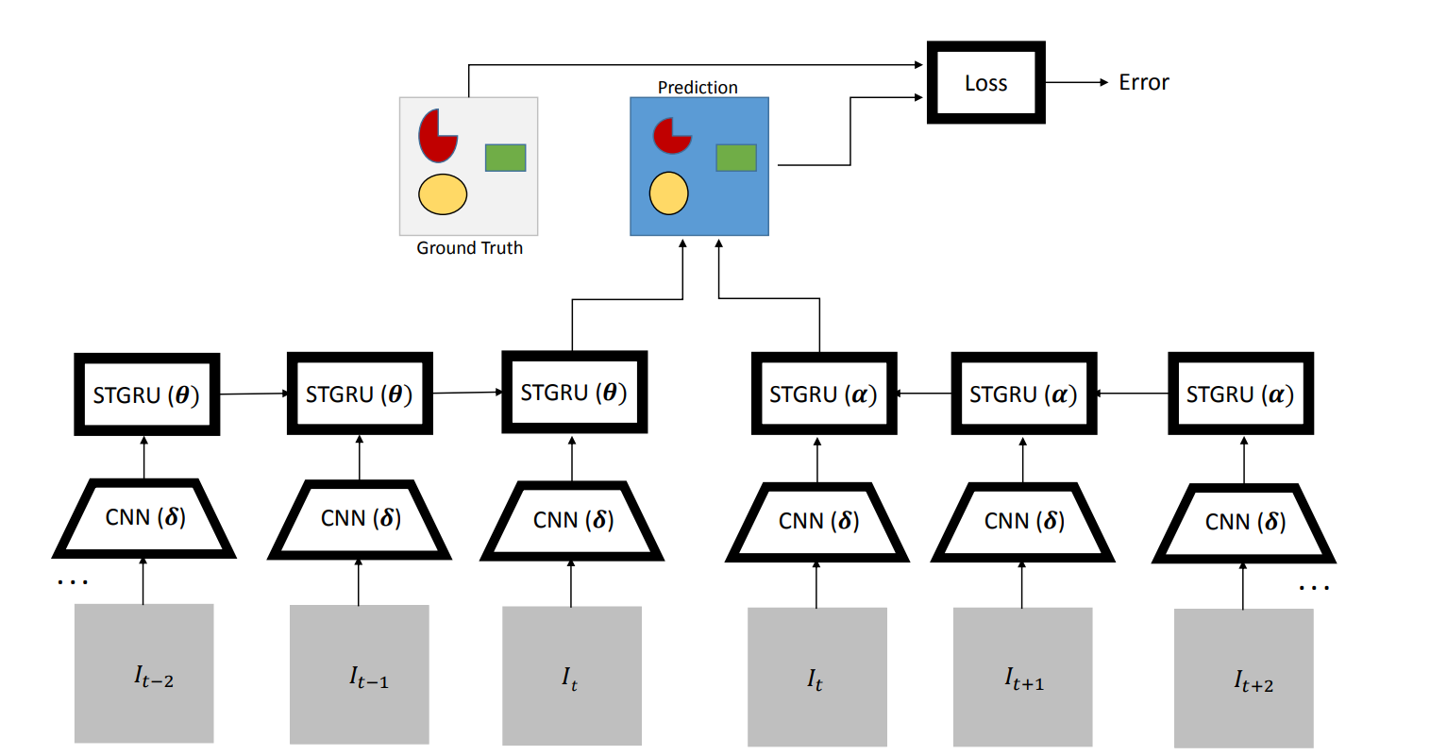
Paper 3 Semantic Video Segmentation by Gated Recurrent Flow Propagation
Spatio-Temporal Transformer Warping
Gated Recurrent Units for Semantic Video Segmentation
Notes:
1.We start with a semantic segmentation at the previous time step, ht−1 and warp it ( wt = φt−1,t(ht−1) )along the optical flow to align it with the segmentation at time t
2. the estimate xt computed by a single frame CNN for semantic segmentation
3.Input wt, xt into GRU , to get the final segmentation ht
To connect the probability maps for semantic segmentation at different frames, ht−1 and ht, we will use a modified convolutional version of the Gated Recurrent Unit
use gating to predict the new segmentation probabilities taking into account if either ht−1 or xt have a high confidence for a certain class in some region of the image.
The predictions from the forward model aggregated over frames t−T, . . . , t−1, t (in the above illustration T = 2) and (when available and desirable) backward model aggregated over frames t+T, . . . t+ 1, t are fused at the central location t in order to make a prediction that is then compared against the ground-truth available only at frame t by means of a semantic segmentation loss function.

Slide 35
Thanks for your attention!

